Slide 1

FACIAL EMOTION RECOGNITION
1602-18-735-063 ALEKHYA T
1602-18-735-074 KEERTHIKA P
1602-18-735-075 KHYATHI K

Slide 2



CONTENTS
Introduction
Software Components
Working
Pre processing of image
Convolution Neural Networks
Construction of CNN
Results
Open CV
Applications and Future Scope
Sustainability
Feasibility
Conclusion

Slide 3

Introduction
Facial expression recognition is the process of identifying human emotion. This is both something that humas do automatically but computational methodologies have also been developed.
In this application faces are matches with the available dataset to find out the human faces. These application are mostly used in biometric, government cyber security areas. The problem over these applications for recognizing facial expression is still an ongoing research. This project is based on image processing and computer vision techniques. This system distinguishing the seven universal emotions: happy, disgust, anger, fearful, sad, surprise and neutral.

Slide 4


SOFTWARE COMPONENTS
Google Colaboratory is a free cloud service and it supports free GPU
Python language
Required libraries : keras, numpy, matplotlib, tensorflow
Model used for emotion detection is Convolution neural networks
Activation function : relu

Slide 5
WORKING
Input dataset
Pre processing of images
Import libraries
Building CNN model
Image cropping
Open CV

Slide 6
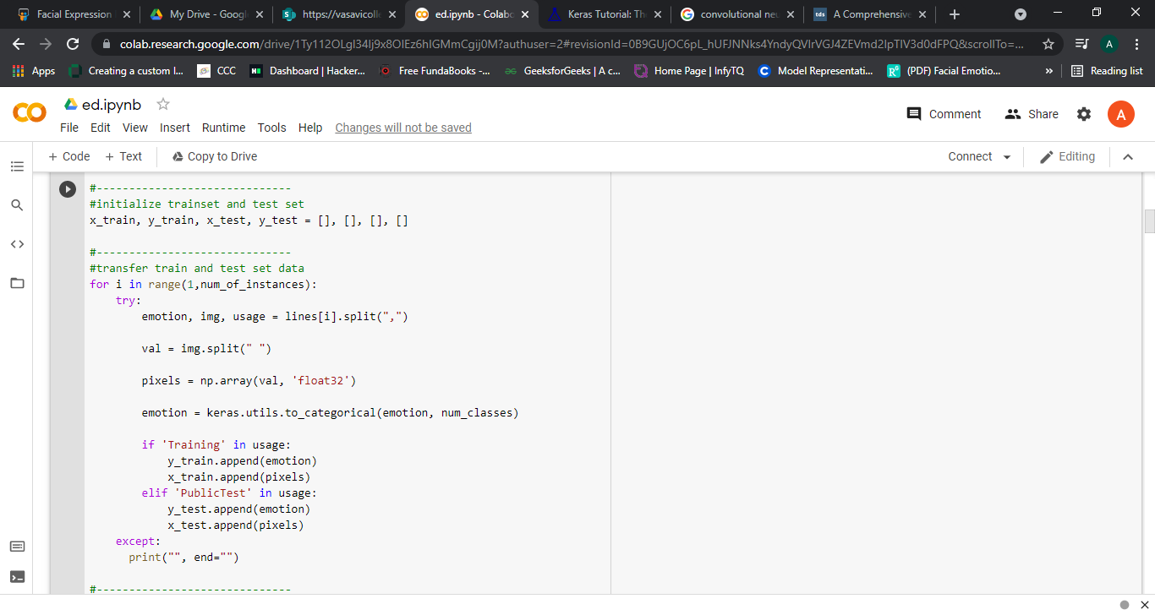
PRE PROCESSING OF IMAGES
Pre processing of data in which the pixel values which are ranging from 0 to 255 are normalized to [0-1]
All the pixel values along with its emotion are made into an array

Slide 7

Table

Slide 8


The objective of the Convolution Operation is to extract the high-level features such as edges, from the input image. ConvNets need not be limited to only one Convolutional Layer. Conventionally, the first ConvLayer is responsible for capturing the Low-Level features such as edges, color, gradient orientation, etc. With added layers, the architecture adapts to the High-Level features as well, giving us a network which has the wholesome understanding of images in the dataset, similar to how we would.

Slide 9


Slide 10
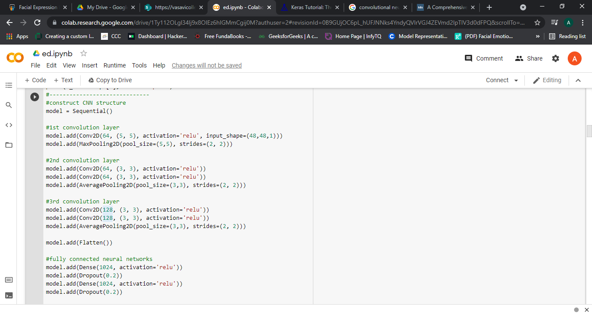
CONSTRUCTION OF CNN

Slide 11
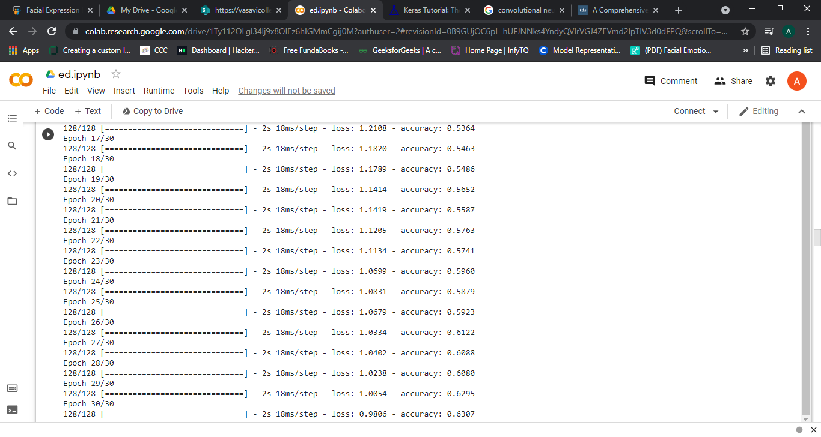
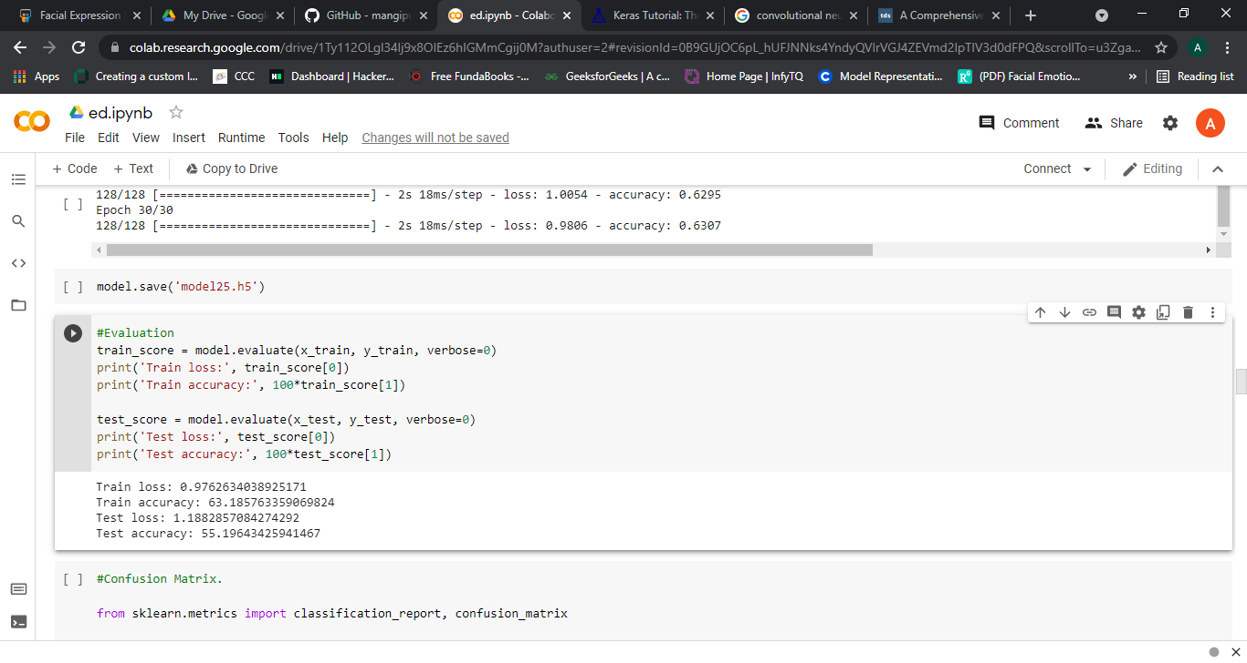
RESULTS

Slide 12
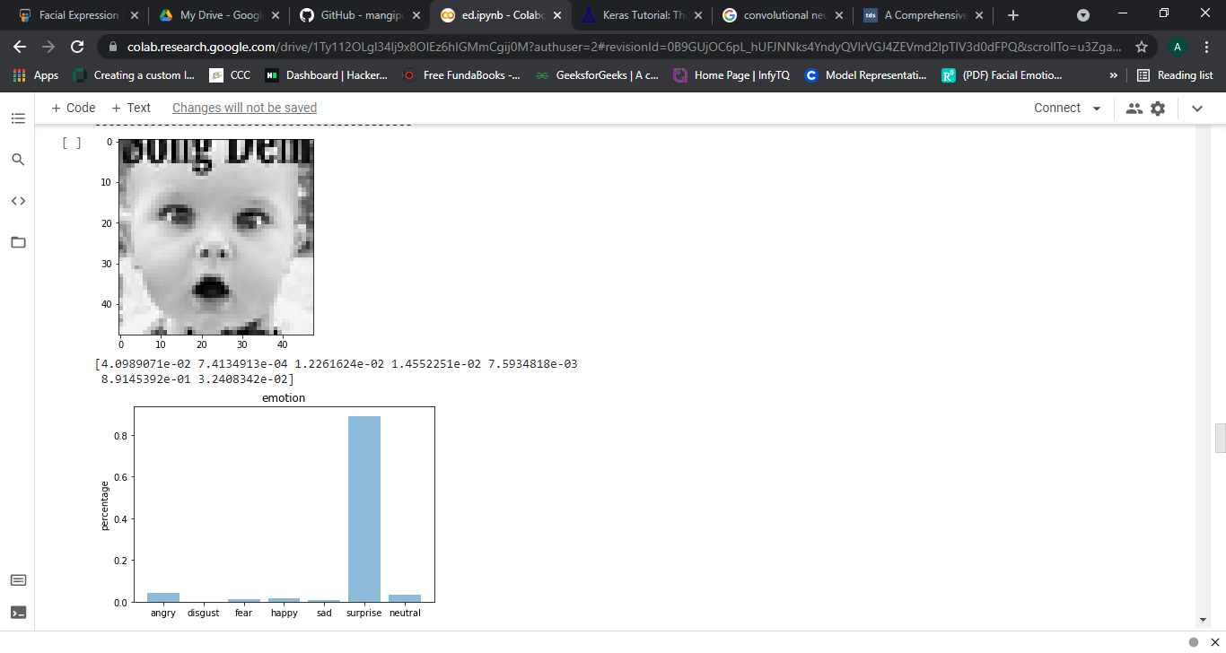
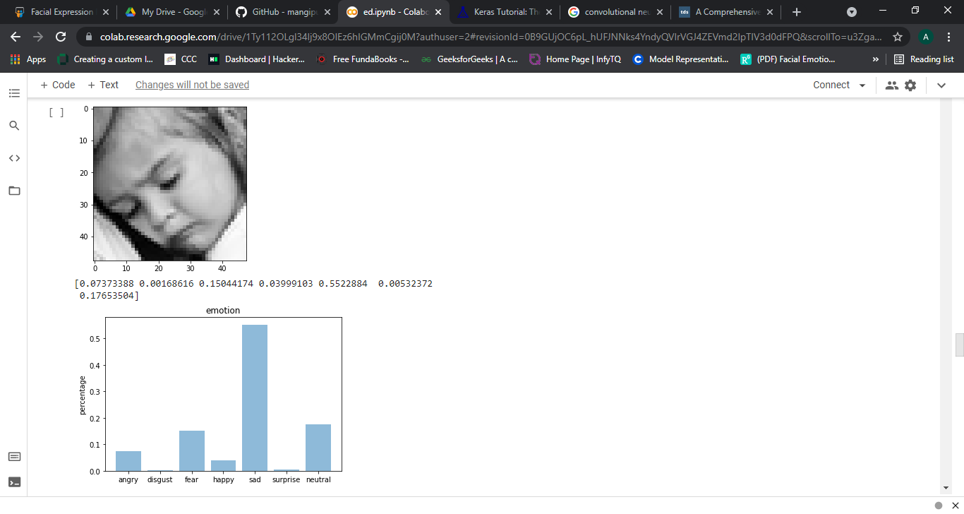

Slide 13
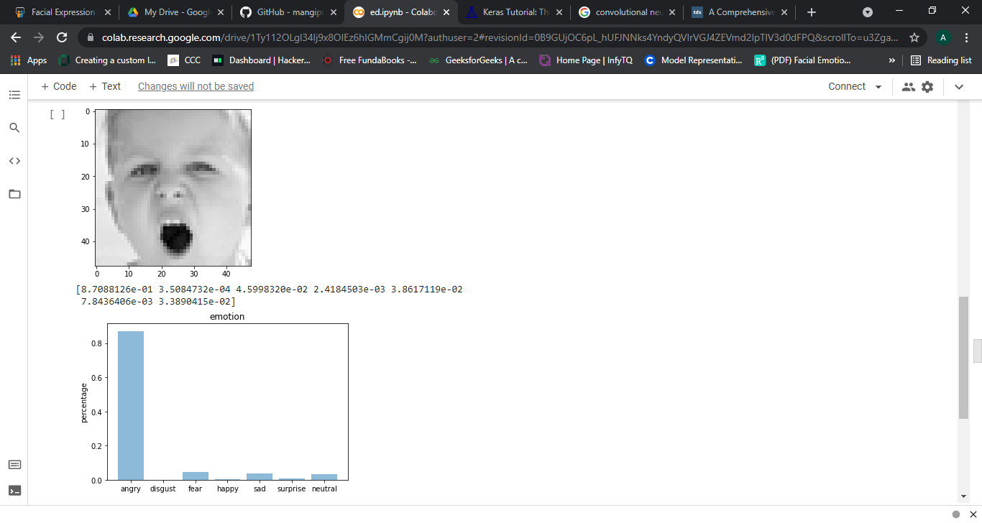
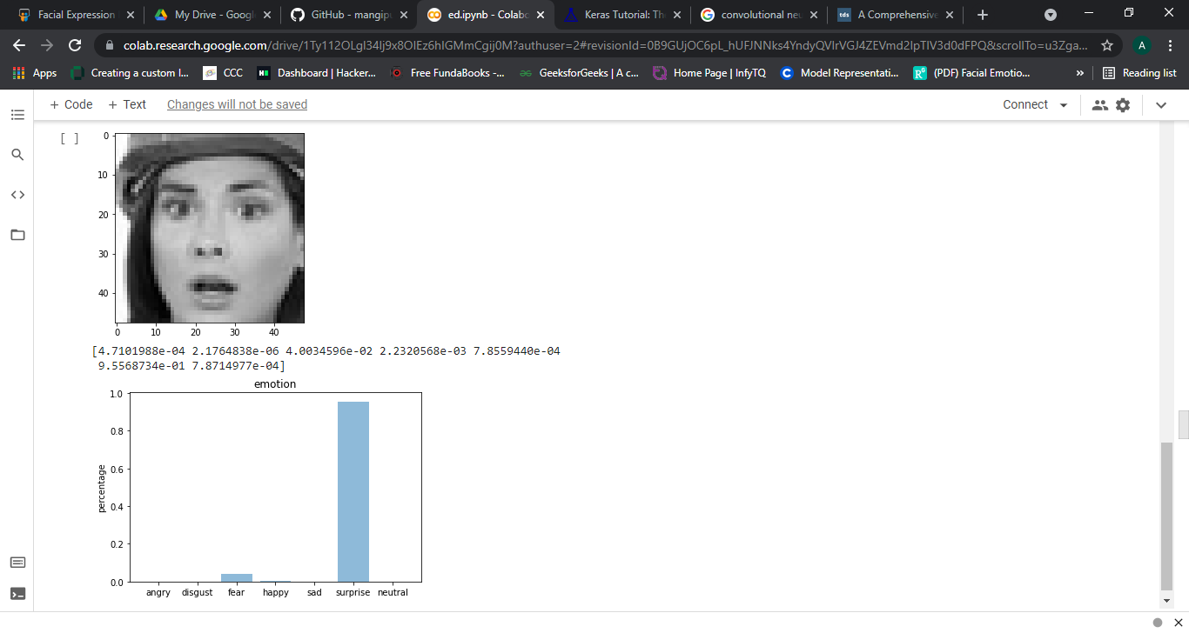

Slide 14
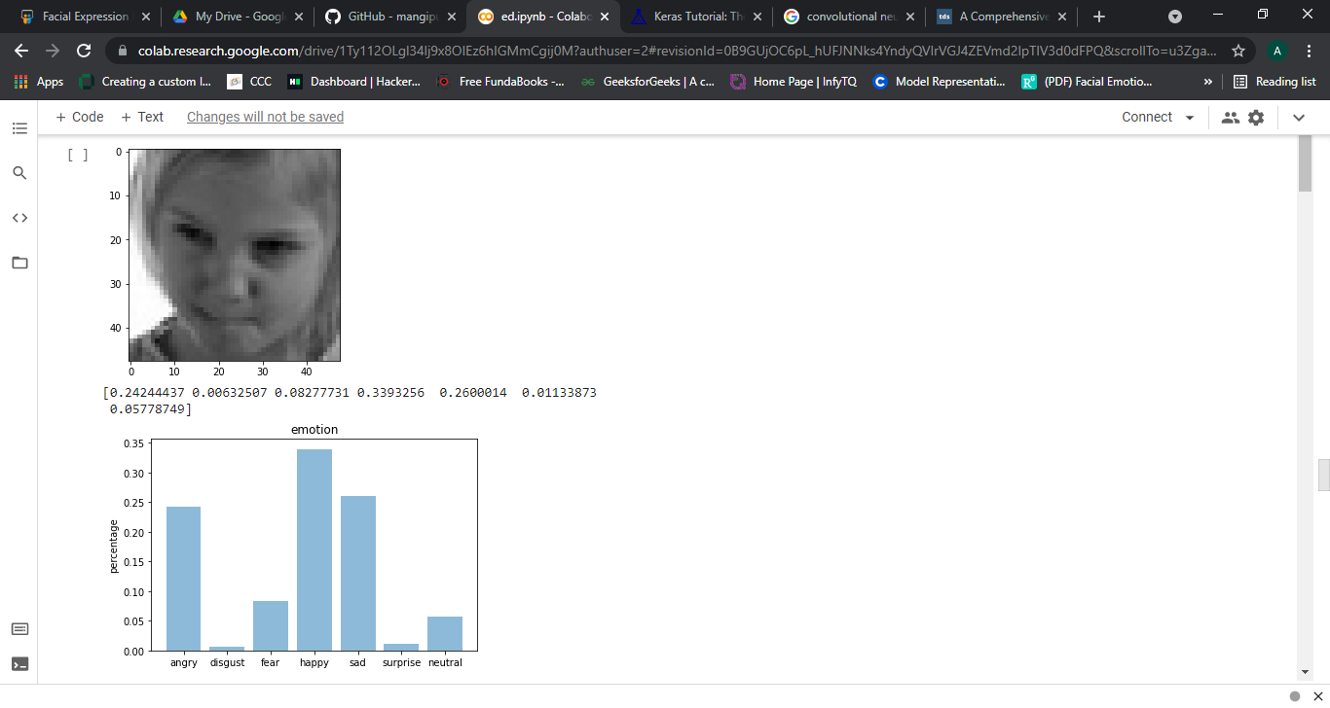
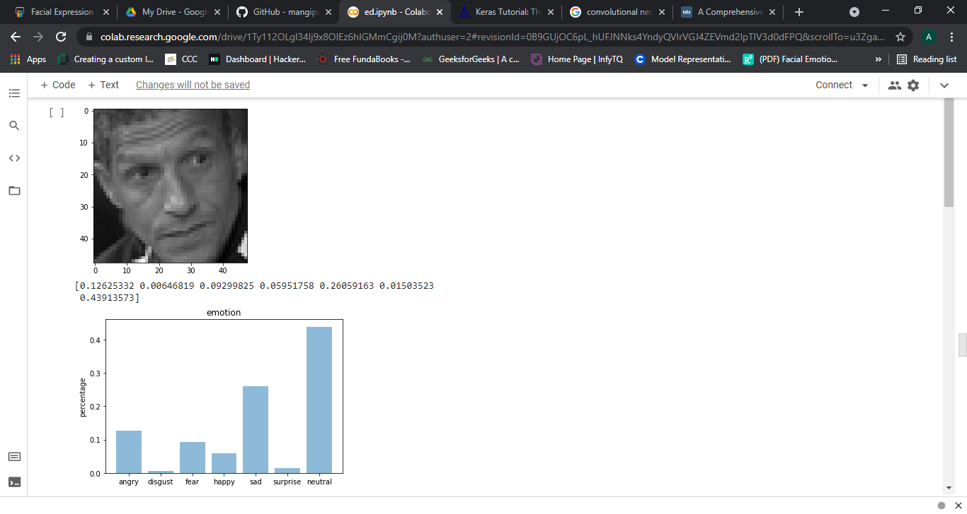
Here the outputs are not predicting correct emotion. So, what to do ?

Slide 15

In the above we can see that the outputs are not accurate.
So, we cropped the images which will read only the facial expressions such that the back ground of the images will not effect the output.
Through this we can enhance the result

Slide 16
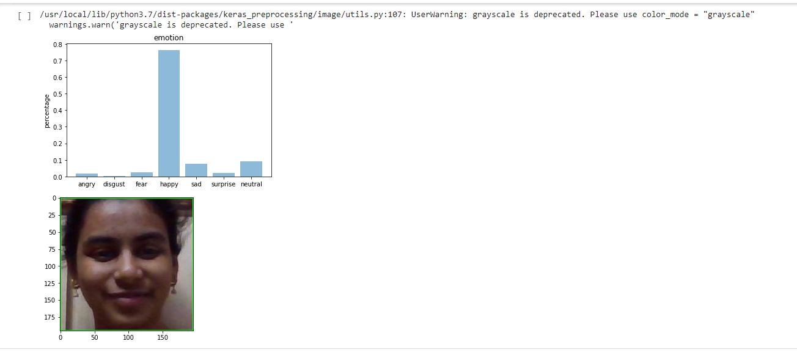
OPEN CV

Slide 17

APPLICATIONS AND FUTURE SCOPE
Marketing and scientific research
Film industries
Cameras or in Cell phone camera applications
Social media
Criminal justice
Content analysis
Healthcare

Slide 18
SUSTAINABILITY
Computers can provide advantages over humans in analysis and problem-solving. Computers that can recognize facial expressions can find application where efficiency and automation can be useful, including in entertainment, social media, content analysis, criminal justice, and healthcare. For example, content providers can determine the reactions of a consumer and adjust their future offerings accordingly.
The system uses Action Units that describe movements of certain facial muscles and muscle groups to classify emotions, facial movements and manipulations in accordance to the emotions of interest, digital image processing and analysis of visual facial features can allow for successful facial expression predictors to be trained, so that it can maintain accuracy to great extent.
Different layers of image can help in facial expression recognition to be successfully performed with relatively low computational requirements.
As the number of images in dataset increases, the accuracy also increased

Slide 19

FEASIBILTY
The development in computer vision and machine learning makes emotion identification much more accurate and accessible to the general population.
It is very easy to implement on laptop and cost free.
Multiple datasets can be obtained from google at no cost, which is affordable.
Many approaches to implement, Online platform is available to perform execution ,no need of installing any softwares( until unless it is necessary).

Slide 20

CONCLUSION
The neural network will be trained using dataset and by adding maximum hidden layer i.e with deep layer in convolution network the result will be calculated. It covers the concept of facial expression recognition with aimed to classify images of faces into any seven discrete emotions.

Slide 21
REFERENCES
M. Saaidia et. al., “Facial Expression Recognition Using Neural Network Trained with Zernike Moments”, IEEE International Conference on Artificial Intelligence with Applications in Engineering and Technology, 2014.
Challenges in representation learning: Facial expression recognition challenge. (2013) http://www.kaggle.com/c/challenges-inrepresentationlearning-facial-expressionrecognition-challenge
Zhiding Yu et. al., “Image based Static Facial Expression Recognition with Multiple Deep Network Learning”, ACM, 2015.
V. D. Bharate et. al., “Human Emotions Recognition using Adaptive Sublayer Compensation and various Feature Extraction Mechanism”, IEEE WiSPNET, 2016
Parkhi, Omkar M., Andrea Vedaldi, and Andrew Zisserman. "Deep face recognition." In bmvc, vol. 1, no. 3, p. 6. 2015.

Slide 22



Slide 23


Thank You

